Slide 1

[Samsung PRISM] Mid Review Report
Explore & Implement Image Augmentation Options
Team
College Professor: Dr U Hariharan
Students:
MATCHA PAVAN KUMAR (20BCS6072)
PRIYANGSHU SARKAR (20BCS6047)
ARPIT MAHAJAN (21BCG1115)
Department: AIT-CSE
Date: 10 JULY 2023

Slide 2
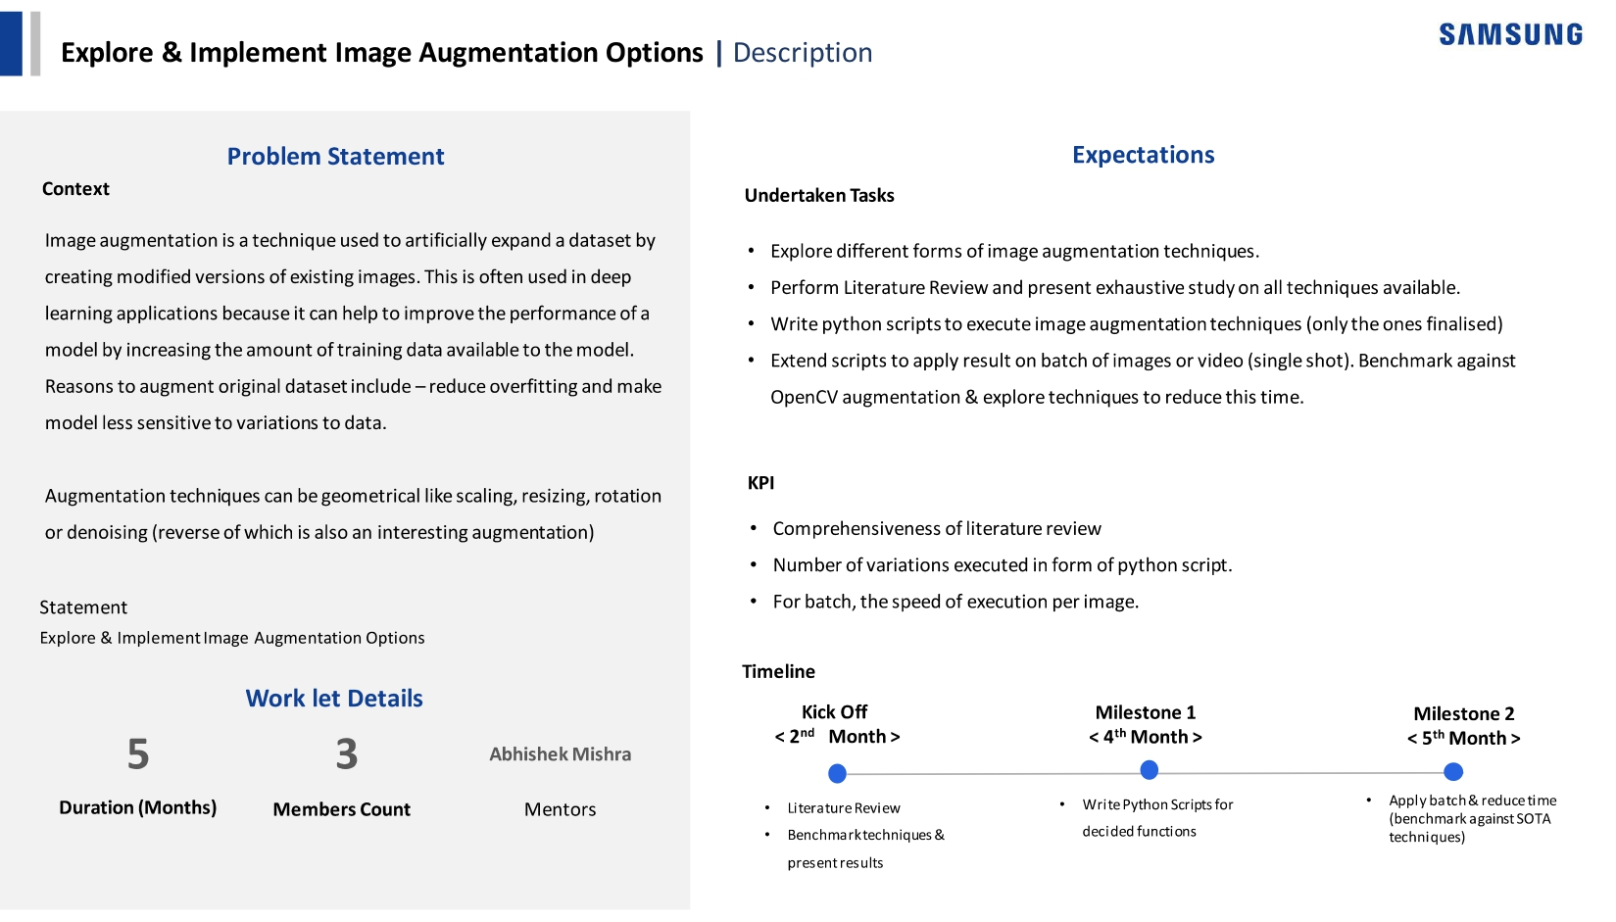
Notes:
-

Slide 3
Proposed Approach / Solution
Goals of Image Augmentation:
To ensure that the trained model learns the appropriate features and have low variance on the test data.
To ensure that the model stands robust to variations in the data.
According to our research:
Augmentation technique is best approach to exaggerate the type feature we want the model to learn.
Augmentation techniques are not best approach in making the model robust to variations in the data.

Slide 4
Proposed Approach / Solution
Why Image Augmentation techniques are not the best approach in developing the model that is robust to all kind of variations?
In order to make the model that is robust all kind of rotations, we need to generate new data for all the images for all degree and at least some degree.
Ex: Total dataset: 3000 images, New Dataset = 3000*360 = 10,80,000
In order to make the model that is robust all kind of shade in color, we need to generate new data for all shades of the image.
And same this goes to achieve translation invariance, scale invariance, etc.
So, Image Augmentation can only be used to improve the representation of the feature we want the model to learn but it does not guarantee us that the developed model will withstand all kinds of variations.

Slide 5
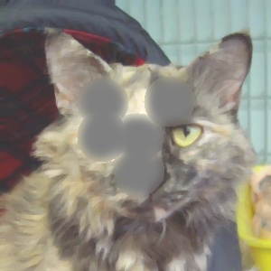
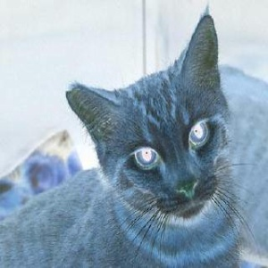
Proposed Approach / Solution
Examples on the usage of Image Augmentation to direct the model to learn the required features:
Activation Suppression
Negative
To guide the model to consider multiple features to infer the output
To improve the edge detection and also to reduce color dependency of the model

Slide 6
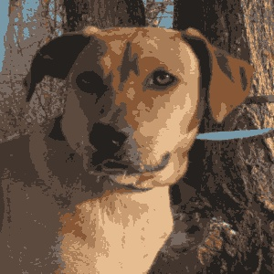
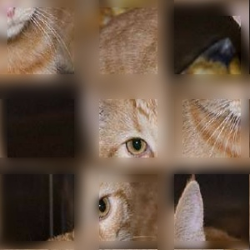
Proposed Approach / Solution
Examples on the usage of Image Augmentation to direct the model to learn the required features:
Color Quantization
Tiles Shuffle
To highlight the structure of the entity but quantizing the colors
To improve the model’s ability to understand the spatial information of the features

Slide 7
Proposed Approach / Solution
Our proposal to achieve the second goal mentioned before:
“How to ensure that the model is invariant to the features it learned”
Idea: Transferable Model
Transferable Model is a type of model where the knowledge learned from one part of the model can be shared with another part of the model. In other words, it is inter model communication mechanism.
In this approach, we train the model to learn the required features using the augmentations and after that, we will transfer that weights the model learning from one part of the layer to another. Due to that, we need not to provide every type of data (If the knowledge is transferable).

Slide 8
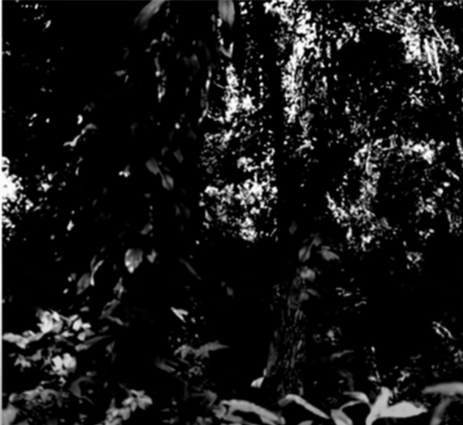
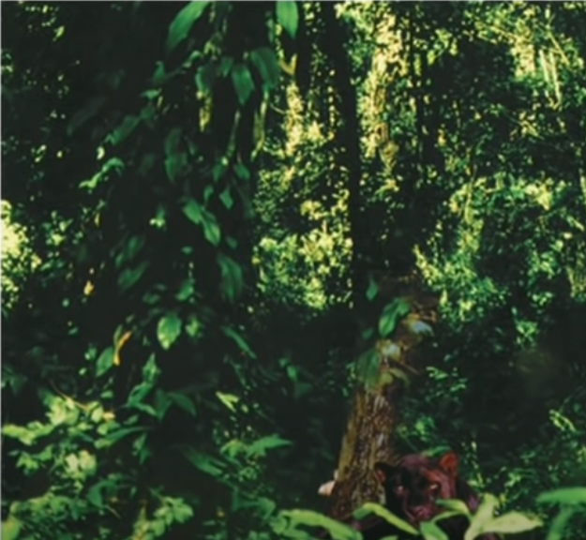
Proposed Approach / Solution
Achieving Color Invariant Model:
Normal Approach: The naïve approach is to provide various shade of the same image. But it is not practical as well as it does not guarantee the model behaves same for every shade. The another approach is to take black and white images.

Slide 9
Proposed Approach / Solution
Achieving Color Invariant Model:
Using Transferable Model: Here, the idea is that during the training process the model learns weights according to RGB order. That means, the model learns the kernels according with Red color channel, Green channel, etc. Now, we will transfer the information (kernel) from one channel to another. That is, the information learned by R-channel will be shared with Blue and Green and so on. Due to this, we need not to train the model with color augmented data.

Slide 10
Proposed Approach / Solution
Calculation:
Sum of convolution of each channel
Implementation:
Input Layer
R + G + B
Output of 32 images

Slide 11
Proposed Approach / Solution
Implementation:
Calculation:
Sum of convolution of RGB channels in order
Input Layer
wr
wg
R + G + B
wb
Output of 32 images

Slide 12
Proposed Approach / Solution
Implementation:
So, in order to transfer weights, we need to perform computation of all combination of RGB channels.
Input Layer
Non-Trainable Layer (BRG)
Non-Trainable Layer (BGR)
Trainable Layer (RGB)
Non-Trainable Layer (RBG)
Non-Trainable Layer (GRB)
Non-Trainable Layer (GBR)
ADD

Slide 13
Proposed Approach / Solution
Achieving Rotational Invariance
So, in order to transfer weights, we need to perform computation of all combination of RGB channels.
Input Layer
Non-Trainable Layer (BRG)
Non-Trainable Layer (BGR)
Trainable Layer (RGB)
Non-Trainable Layer (RBG)
Non-Trainable Layer (GRB)
Non-Trainable Layer (GBR)
ADD

Slide 14
Proposed Approach / Solution
Advantages of this approach:
Here, we need to only consider the training of that single layer. So, we only need to make sure that the low-level features are being detect properly and using transferability, we can transfer the knowledge (based on the color channels of the training data) into other combinations.
Training time and computer resources can be saved as we need not to train the model using new color augmented data.
The amount of time taken to make the model color invariant is very low.

Slide 15
Proposed Approach / Solution
Achieving Rotational Invariant Model
Normal Approach: The naïve approach is to rotate the training dataset at all angles or at least to some angle. It is an impractical approach and also it does not guarantees that the model is rotational invariant.
Other Approaches Include:
Spatial Transformer Networks (STN)
Transformation-Invariant Pooling (TI-Pooling)
Rotation Equivariant Vector Field Networks (RotEqNet)
Harmonic Networks (H-Net)

Slide 16
Proposed Approach / Solution
Achieving Rotational Invariant Model
Using Transferable Model: Here, the idea is that during the training process the model learns weights to detect the features. After learning the kernel weights, the weights are transferred to other layers which are maintaining information of 90, 180 and 270 angles. After passing the data into each of the layers the kernels which are activated with maximum value are selected.

Slide 17

Proposed Approach / Solution
Achieving Rotational Invariant Model
Original Kernel
90 Rotated
180 Rotated
270 Rotated

Slide 18
Proposed Approach / Solution
Achieving Rotational Invariant Model
Previous Layer
Non-Trainable Layer (90)
Trainable Layer (0)
Non-Trainable Layer (180)
Non-Trainable Layer (270)
Maximum

Slide 19
Proposed Approach / Solution
Achieving Rotational Invariant Model
Previous Layer
Non-Trainable Layer (90)
Trainable Layer (0)
Non-Trainable Layer (180)
Non-Trainable Layer (270)
Maximum

Slide 20
Proposed Approach / Solution
Reasons to choose only [90, 180, 270]:
These are the angles which have highest variance. So, more the variance in the training set -> more information the model have to learn.
The deeper layer are sensitive to rotations. So, if we have these rotational invariant blocks from the top layers, as we go into the deeper, the data settle down at these angles.
Also, to ensure that the model is not very wide. The model which is very wide has high memory requirements as well as it take more time to perform predictions.

Slide 21
Proposed Approach / Solution
Advantages of this approach:
Here, we need to only consider the training of that single layer. So, we only need to make sure that the features are being detect properly and using transferability, we can transfer the knowledge to different layers handling different angles.
Training time and computer resources can be saved as we need not to train the model using all the rotations.
The amount of time taken to make the model rotational invariant is very low.
And also, here we only need to take care of making the model learn adequate feature so the number of filters can be low. Due to that, we can make the model even smaller.

Slide 22
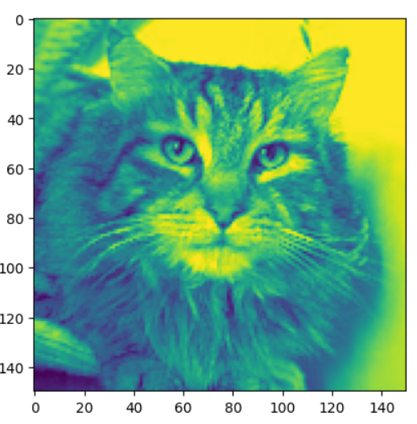
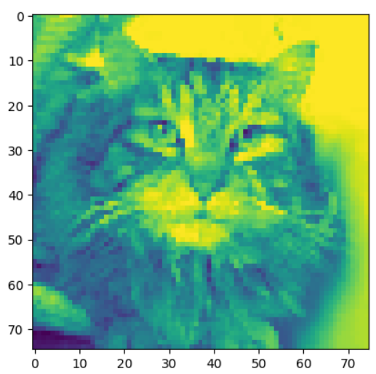
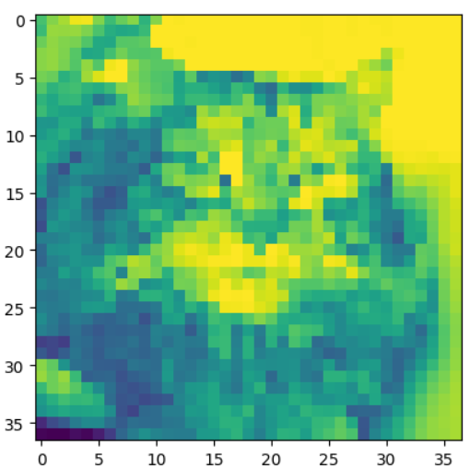
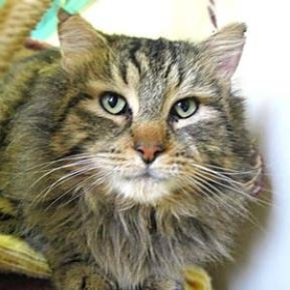
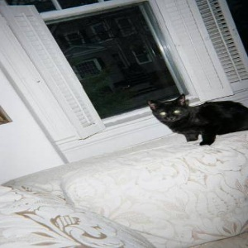
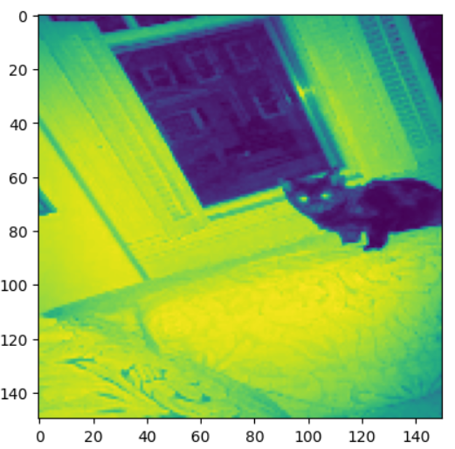
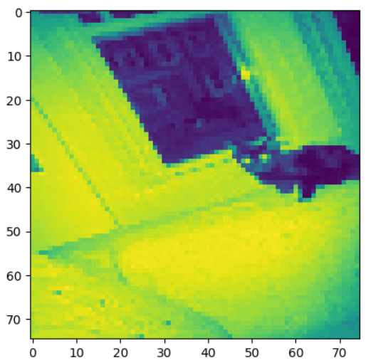
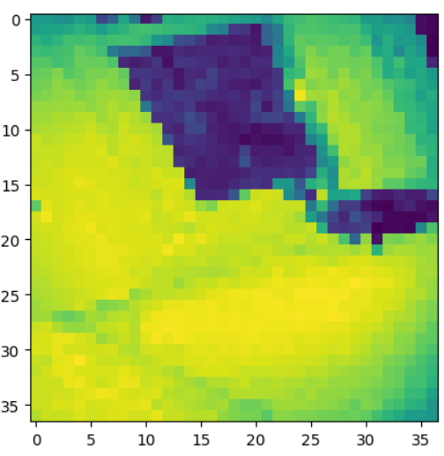
Proposed Approach / Solution
Achieving Scale Invariance and why it is important:
Input Image
First Max Pooling
Second Max Pooling
Third Max Pooling

Slide 23
Proposed Approach / Solution
Proposed Solution:
In order to achieve scale invariance, we need to have a mechanism where the weights from the deeper layers communicate with the weights in the upper layers. If the subject is small in the given frame, then the weights from the deeper layers can be used at the upper layers to detect if object present at that scale. It should be like a feedback mechanism for the communication between the top layers and the deeper layers

Slide 24
Dataset(s) Analysis / Description
Dataset Capture / Preparation / Generation :
Name: Cat vs Dog
Training Size: 3000 (1500 Cat, 1500 Dog)
Test Size: 22000 (11000 Cat, 11000 Dog)
Dataset Understanding / Analysis :
It is the popular cat vs dog dataset. All images in the dataset are naturally taken with various lighting conditions and various scale of the subject. It have different types of cats and dogs with different breeds and colours with various texture.
The dataset is biased towards black cats and brown dogs.
Dataset Pre-Processing / Related Challenges (if any) :
All images are resized to 300x300.
Inflated data includes: 1 Pixel shift and flip (To improve the texture detection), Negative coloring (To direct the model to detect edges), Activation Suppression (To improve the generalizability of the model).
In the generation of the above dataset, the time consumed is a challenge.

Slide 25
Model Details
Input L.
32, 2X2
BGR
BRG
RGB
RBG
GBR
GRB
32, 3X3
BGR
BRG
RGB
RBG
GBR
GRB
Conv
32, 1x1
ADD
ADD
Blur
Max P
32, 3X3
Conv - 90
Conv - 0
Conv - 180
Conv - 270
Conv
32, 1x1
Maximum
ADD

Slide 26
Model Details
64, 3X3
Conv - 90
Conv - 0
Conv - 180
Conv - 270
Conv
64, 1x1
Maximum
ADD
128, 3X3
Conv - 90
Conv - 0
Conv - 180
Conv - 270
Conv
128, 1x1
Maximum
ADD
Global Max Pooling
Dense
3 units in the output layer

Slide 27
Experimental Results / Simulations / Observations
Results:
Color Invariance Test:
Test conditions: 3000 images with random shades stacked on top of them
Model | Result
TEST 1
Model without any transfer of weights | Cat accuracy: 74.36% Dog accuracy: 61.83%
Model with transfer of weights | Cat accuracy: 96.86% (22.5+) Dog accuracy: 86.76% (24.9+)
TEST 2
Model without any transfer of weights | Cat accuracy: 77.03% Dog accuracy: 51.03%
Model with transfer of weights | Cat accuracy: 92.33% (15.3+) Dog accuracy: 80.60% (29.5+)
Amount of time taken to get this effective: under 5 sec

Slide 28
Experimental Results / Simulations / Observations
Results:
Rotational Invariance Test (Large Model – 10 MB):
Test conditions: 21,480 test dataset rotated at specified degrees
Angle | Transferred Model | Non-Transferred Model
0º | Cat accuracy: 90.12 Dog accuracy: 89.72 | Cat accuracy: 90.22 Dog accuracy: 90.11
90º | Cat accuracy: 88.21 Dog accuracy: 87.69 | Cat accuracy: 75.18 Dog accuracy: 72.70
180º | Cat accuracy: 86.75 Dog accuracy: 88.57 | Cat accuracy: 64.40 Dog accuracy: 72.83
270º | Cat accuracy: 88.00 Dog accuracy: 87.34 | Cat accuracy: 76.28 Dog accuracy: 74.72
Random | Cat accuracy: 88.39 Dog accuracy: 89.23 | Cat accuracy: 83.06 Dog accuracy: 62.24

Slide 29
Experimental Results / Simulations / Observations
Results:
Rotational Invariance Test (Small Model – 2.29 MB):
Test conditions: 21,480 test dataset rotated at specified degrees
Angle | Transfer Model | Non-Transferred Model
0º | Cat accuracy: 86.74 Dog accuracy: 84.5 | Cat accuracy: 90.29 Dog accuracy: 86.95
90º | Cat accuracy: 83.32 Dog accuracy: 83.68 | Cat accuracy: 64.94 Dog accuracy: 72.79
180º | Cat accuracy: 85.71 Dog accuracy: 82.26 | Cat accuracy: 57.28 Dog accuracy: 71.20
270º | Cat accuracy: 83.71 Dog accuracy: 84.15 | Cat accuracy: 70.95 Dog accuracy: 72.71
Random | Cat accuracy: 85.31 Dog accuracy: 81.64 | Cat accuracy: 68.73 Dog accuracy: 71.11

Slide 30
Experimental Results / Simulations / Observations
Major Observations / Conclusions & Challenges :
Based on our research, Augmentation techniques should only be used in limited fashion. They should only be used to guide the model to detect the right features.
Augmentations should not be considered as the solution for making the model stable or robust to various transformations. It may solve the problem for some extend but it is not a reliable approach.
If we want to make a model that is robust to changes, we should incorporate that in the model architecture.
If we can develop a method to perform inter model communication, we can make the model to perform more with less training. This overall, improving the computer vision pipeline.
With transferable model approach, we can make smaller models as we don’t need many parameters as the knowledge can be transferred.

Slide 31
Further Plan to Complete Project
Final Probable Deliverables :
Next, we are trying two things: 1. Research regarding the scale invariant model and other transformations. 2. Research regarding the augmentation techniques that can improve the feature detection with less computation.
We need your help in letting us know whether we are in the right direction. If so, we need your help in how to develop a new architecture that have inter-model communication capabilities.
IP Target / Plan :
There is no articles or papers regarding the intermodal communication mechanism. So, we can definitely write a research paper.
We are still researching if this idea is original so that we can patent on it.

Slide 32
Further Plan to Complete Project
Completion Plan:
Week 1 to 2
Through research on the architectural change that the possible.
Week 2 to 4
Implementing the approaches if we find any method.
Week 5 to 6
Standardizing the code. So, we can use them directly and also it should be applicable in the current approaches of model building.
Week 7 to 8
Finalizing everything from implementation, testes and research paper as well.
Research regarding the new augmentations that guides the model in feature detection.
Performing various tests on the approach
Challenges Anticipated:
Some of the concepts we mentioned as very new and there is less community in terms of implementation. So, that can be challenging from implementation perspective.
Git Upload details: All files with necessary documentation are uploaded in the Git Hub.

Slide 33
Thank you

